Slide 1

Team E⁴
Members:
Caleb Olson
Sean Basler
Montana Kempfer
Andrew Kueny

Slide 2
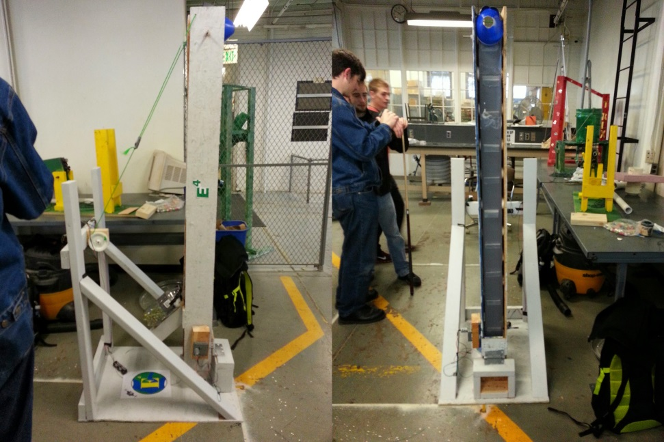
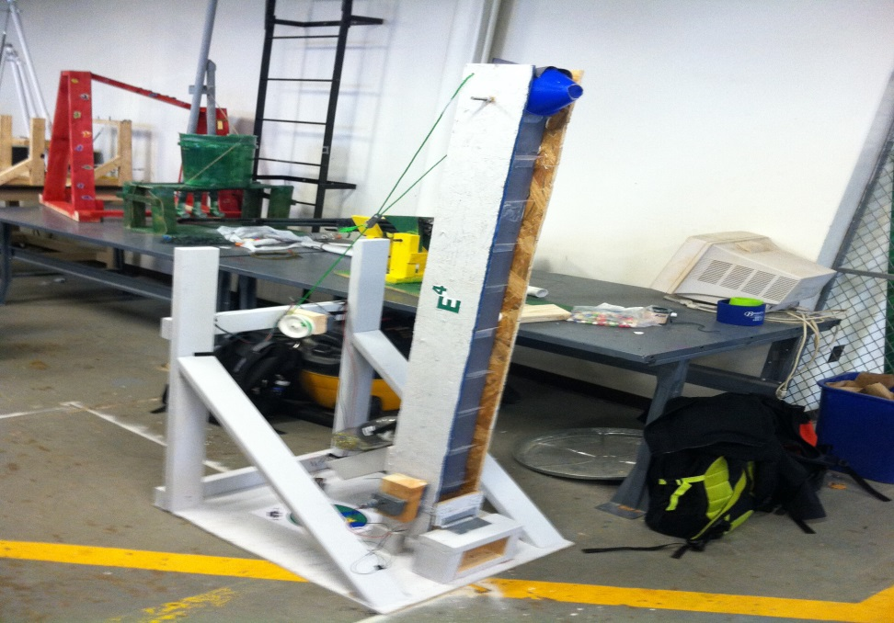
Final Project Functionality
The Winch
The Conveyor Belt
The Hopper
The Funnel

Slide 3
Project Summary
Test | Expectations | Results
Alpha | Reach the third target, Conveyor belt maneuverability, Operational motor, Working hopper. | The design met most expectations, however the hopper fell off and it failed to get any points.
Beta | Functional winch, Hoped to score all points | The winch worked, We failed to score any points due to overextended barrier and friction.
Final | Better grip to turn the conveyor belt, Functional switch system, Controlled hopper distribution, Hoped to score all points | Grip worked fine, Switch System were functional, Hopper Distribution failed initially through testing, Scored half of our possible points.

Slide 4
Lessons Learned
Alpha – we needed dividers for the conveyor belt to keep the marbles moving forward and we needed to keep the hopper from falling off .
Beta –the barriers needed to be closer together and make the plastic dividers smaller.
Outside Testing – We needed better grip on conveyor belt, hole on the hopper needed to be smaller, coordinated the switches.

Slide 5

If we could start over…

Slide 6
